Slide 1

RF Water Node Deployment and Best Practices
Mark Harkins, Project Manager
Steve Schulberg, Sr. Program Manager

Slide 2
Agenda
Water Node and Water Meter Best Practices
Field Tool Applications
Water Node Troubleshooting
Scenarios
Notes:
Welcome to the water node session. Most of you have become quite good at installing water nodes as well as troubleshooting water nodes. Today we are going to (See agenda) Our goal is to leave you with some tools and techniques to use to have successful water node installations. We also would like to hear from you on water node best practices and or issues you see to share with the group.

Slide 3
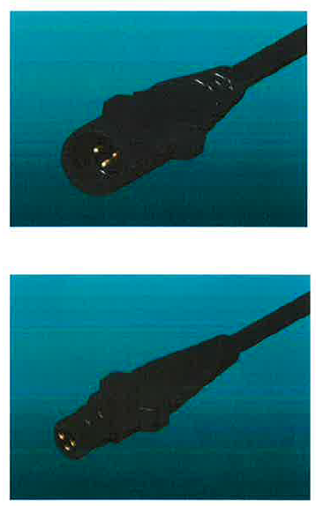
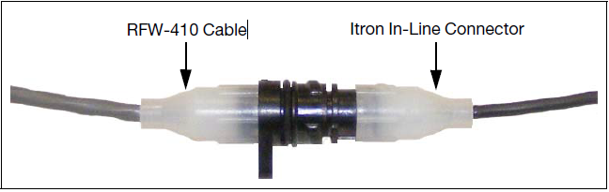
Water Node Wiring – Direct Connect
Itron Connector
Nicor Connector

Slide 4
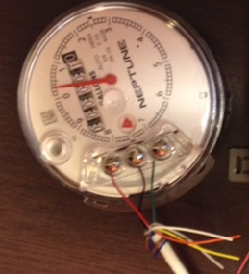
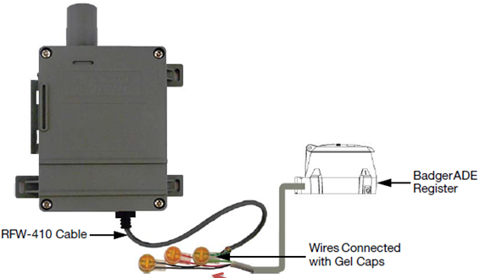
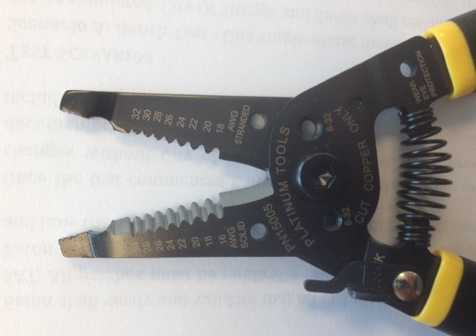
Water Node Wiring –Wired

Slide 5
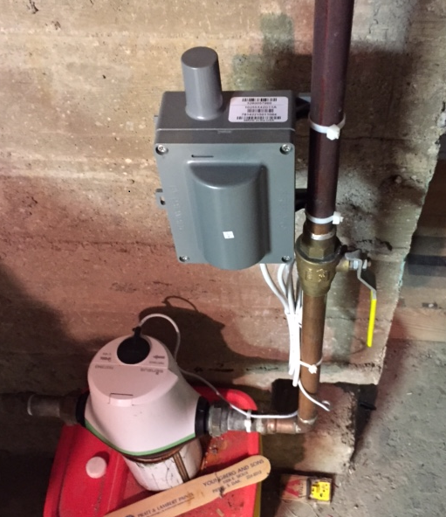
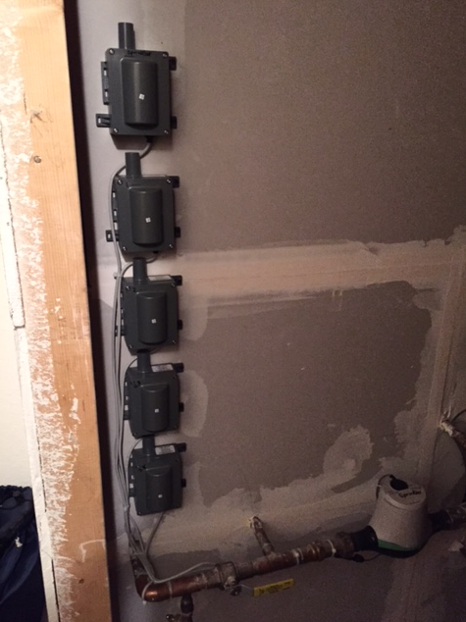
Water Node Wiring –Wired
Notes:
Location – How close are you to the host? Inside/outside.

Slide 6
Water Registers that interface with Eaton’s Water Node
Badger Meter
RTR (pulse)
ADE (encoder)
HR-E (encoder)
Sensus
ICE (encoder
iPERL (encoder)
Itron / Actaris (encoder)
Master Meter (encoder)
Elster / AMCO
Envision (encoder)
SM700 (encoder)
Neptune
ProRead (encoder)
E-Coder (encoder)
Mueller / Hersey (encoder)
Metron Farnier (encoder)
Zenner Performance (encoder)

Slide 7
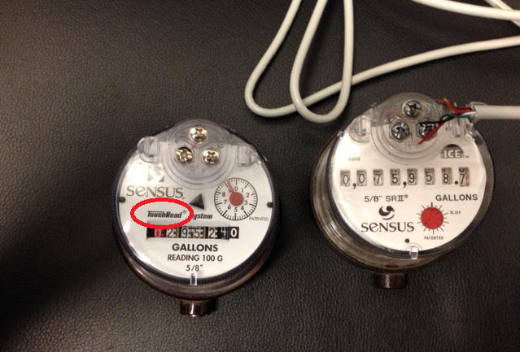
Sensus TouchRead® Water Registers
Yukon™ will not read a Sensus TouchRead® Register
Notes:
The register is mechanical, not digital. Will take higher amount of battery usage open relay.

Slide 8
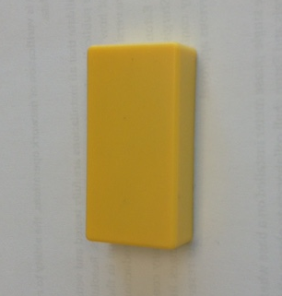
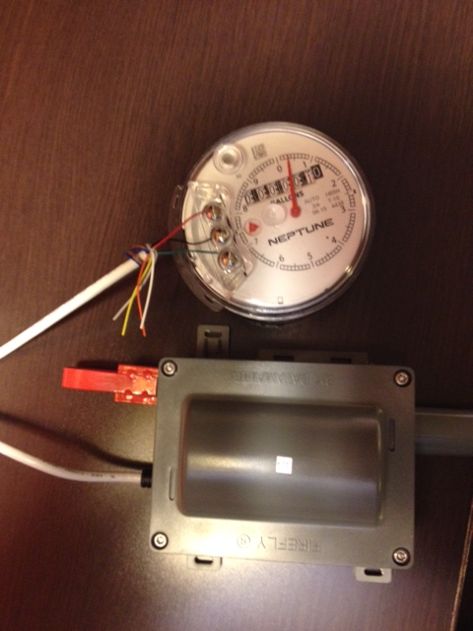
Magnet Placement
Why do we need a Magnet?
What size of Magnet do we need? (5/8” thick, 2” long, ¾” wide)
Where does the Magnet go?
Notes:
What happens if you leave a magnet on. The node will continue to transmit. The battery will last about a week.

Slide 9
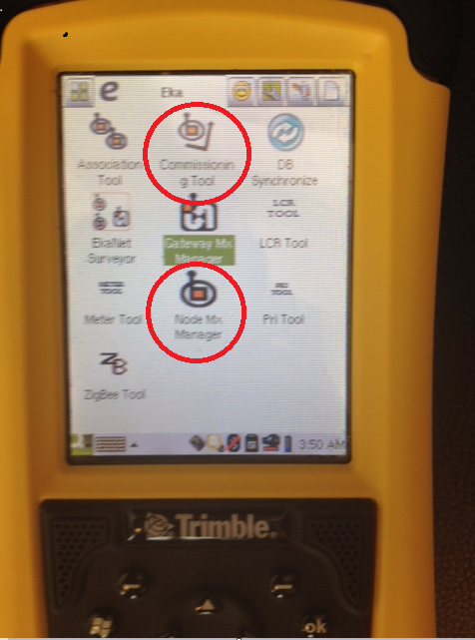
Field Tool Water Applications
Commissioning Tool
Node MX Manager

Slide 10
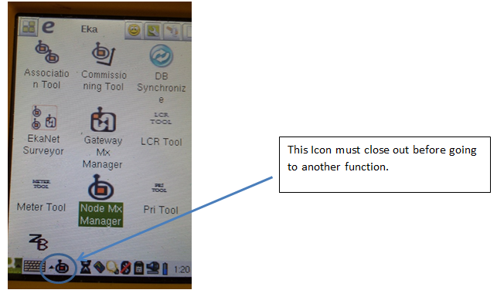
Field Tool Water Applications
Switching between applications

Slide 11
Field Tool Water Applications
Field Tool Will Not Power Up
Has the field tool been charged up?
Remove the ribbon cable from the top of the radio
Remove the battery from the Trimble unit
Watch until the screen is blank
Replace battery (Not the ribbon cable)
Turn Tremble unit on
If applications show on screen attach ribbon cable

Slide 12
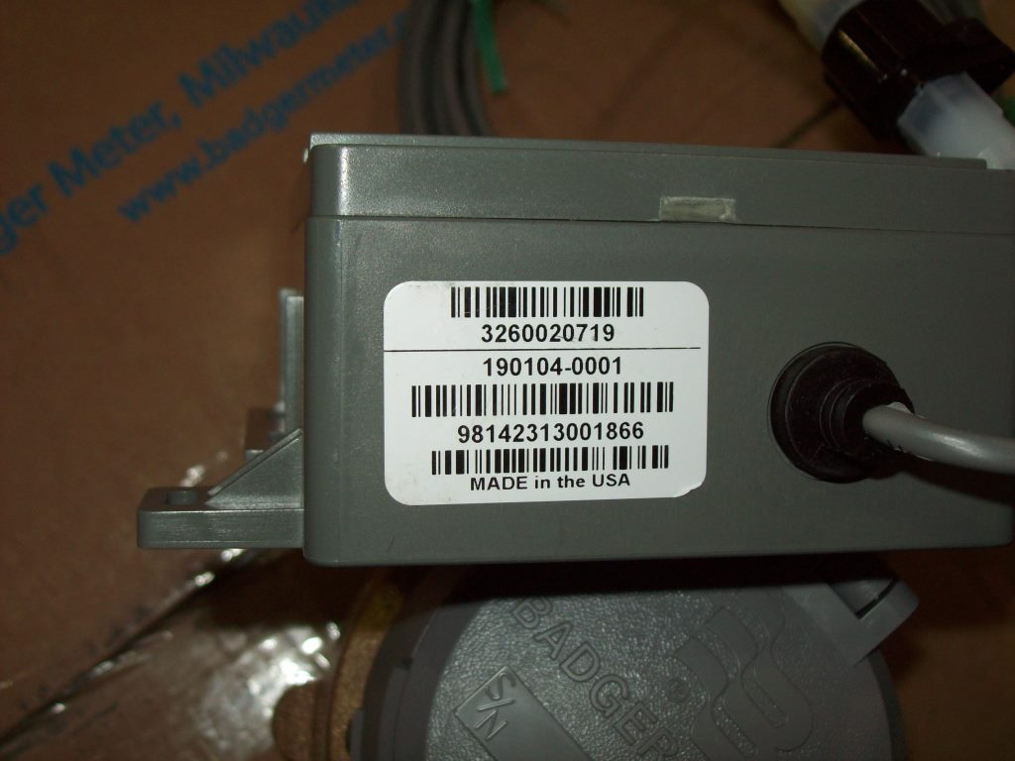
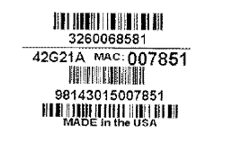
Collecting and Using MAC Address Data
The Node Serial number
New Format in 2016

Slide 13
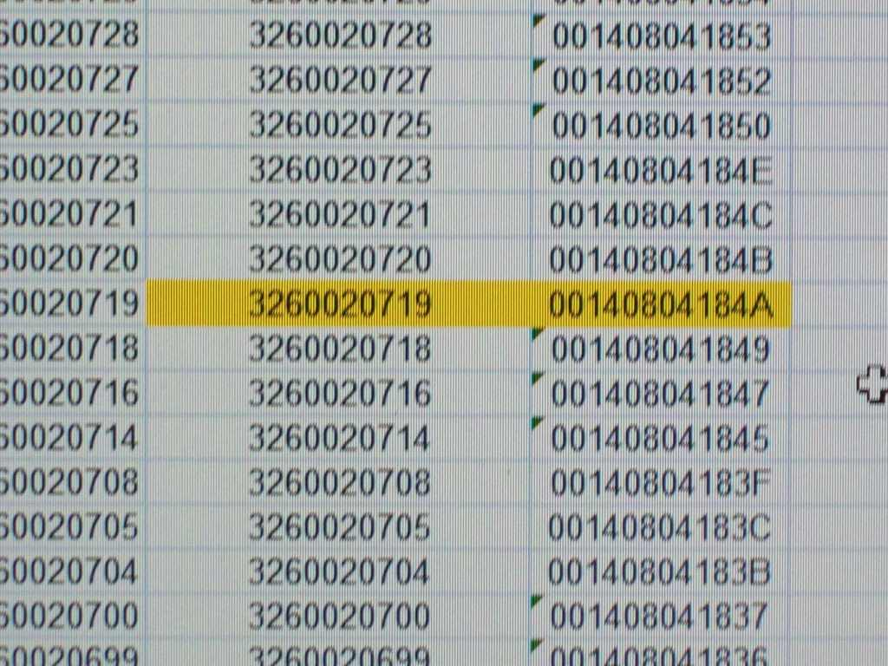
Collecting and Using MAC Address Data
Node Serial # MAC ID
Notes:
It is a common practice to write the last 6 numbers of the MAC ID [see bracket around the end of the MAC ID] on the backside of the Water Node with a Permanent Marker, since the first 6 numbers are already pre-populated in the Field Tool, once you start the process for entering in the MAC ID. You will find this very helpful during the installation process.

Slide 14
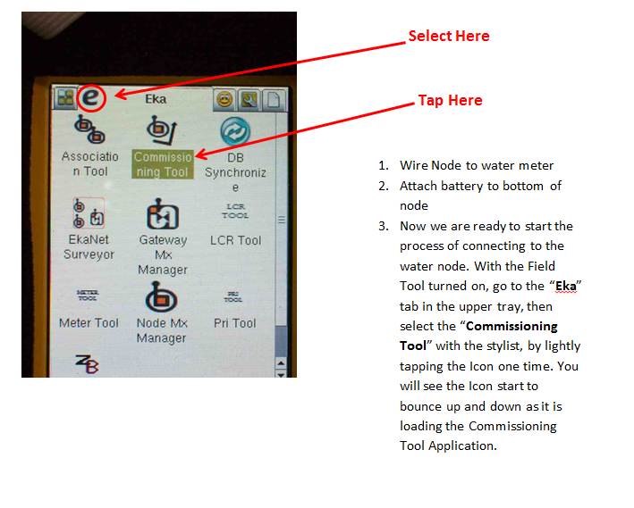
Water Node Commissioning

Slide 15
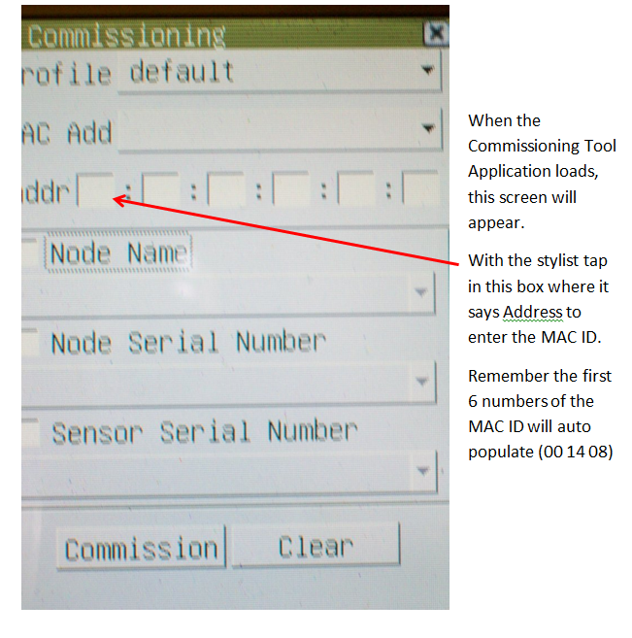
Water Node Commissioning

Slide 16
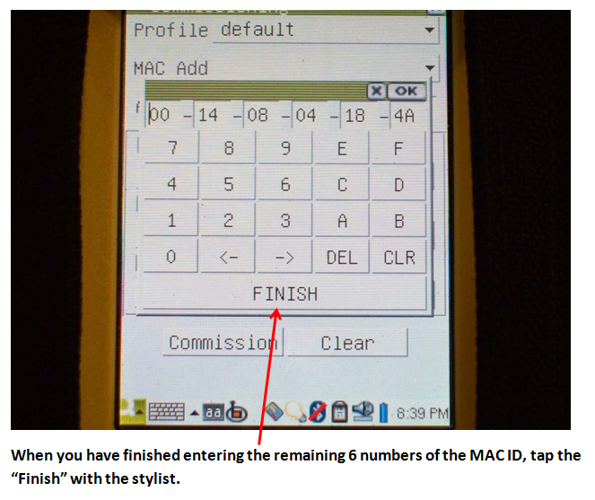
Water Node Commissioning

Slide 17
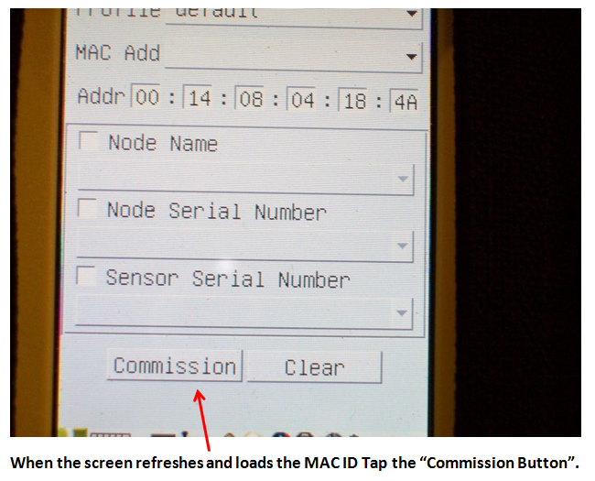
Water Node Commissioning

Slide 18
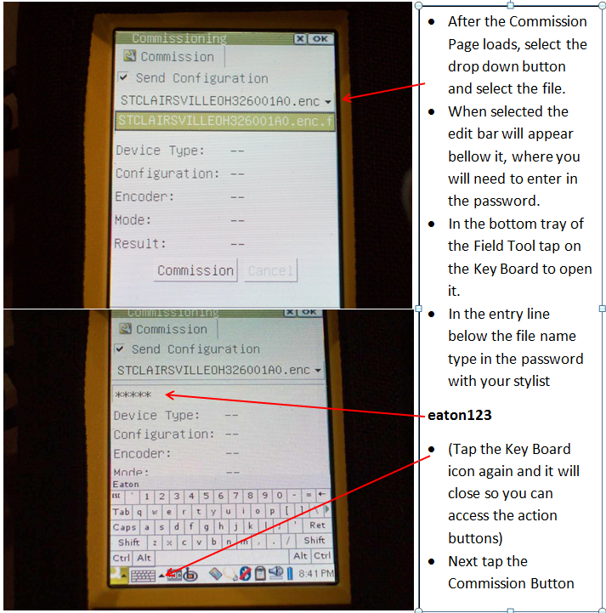
Water Node Commissioning

Slide 19
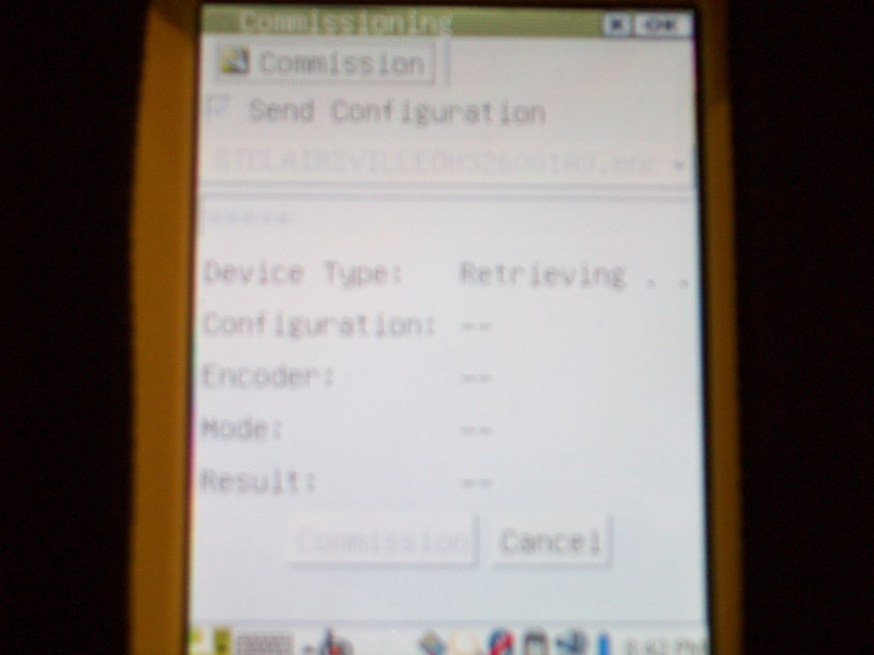
Water Node Commissioning
Notes:
When the meter acquires a connection to the node you will see it first start the retrieving process. If the Commissioning of the Node is successful the screen will show the results listed in the Screen Below. If you see failures in these locations, then it was not Commissioned. It will also let you know if the Failure was due to no initiation with the Water Register.
What the Commissioning Process is doing here, is loading the Customer Profile into the Water node, taking the Node out of Ship Mode (battery off), then verifying it can read the water meter.

Slide 20
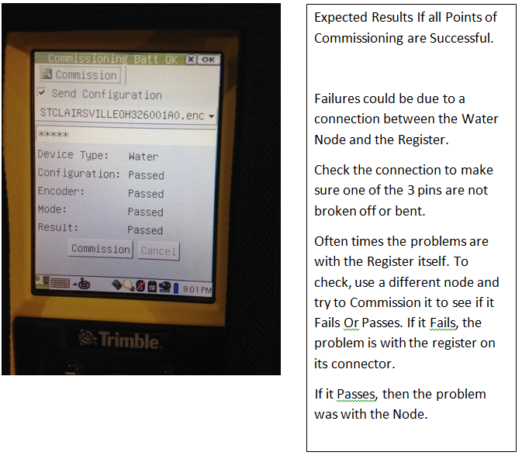
Water Node Commissioning

Slide 21
Commissioning Troubleshooting
When verifying commission and you get a fail the first time, try again. Sometimes the timing of the command gets missed on the first attempt.
Sometimes you will not get a register number to display while commissioning or a failure message. Typically the node commissioned, it just did not see the register. Hook up the register and verify.

Slide 22
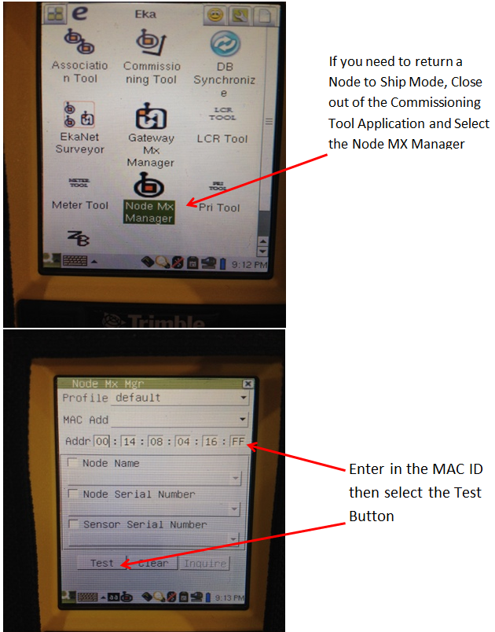
Verifying Ship Mode

Slide 23
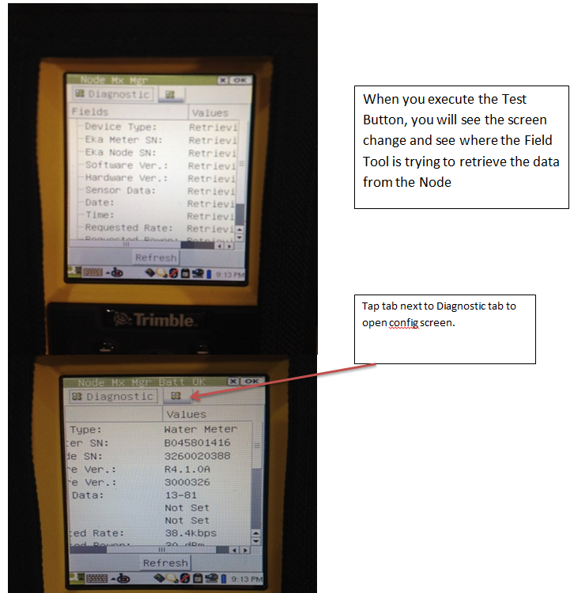
Verifying Ship Mode

Slide 24
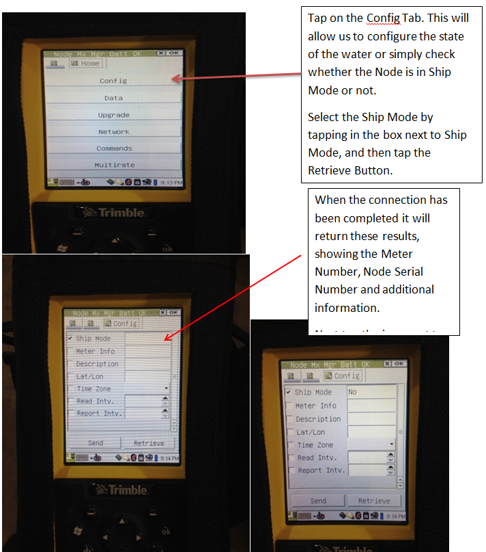
Verifying Ship Mode

Slide 25
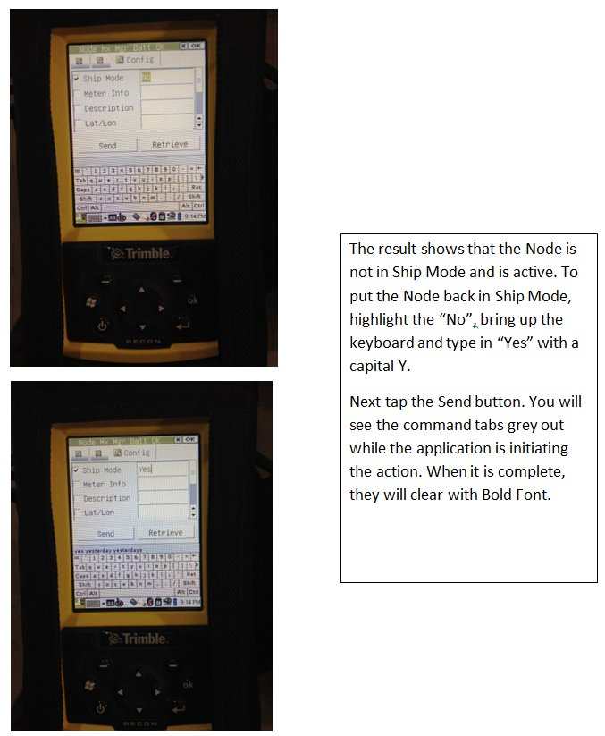
Verifying Ship Mode

Slide 26
Water Node Reporting into Yukon Expectations
Typically it takes between three to four days for a water meter to report into Yukon™
Why? (Lots of back and forth communications)
Water node looks for a host > Host verifies it is a water node and reports to Gateway > Gateway sends date and time to host to give to water node > Water node responds back to host > Host responds to Gateway > Gateway reports information to Network Manager > Network Manager reports to Yukon™.

Slide 27
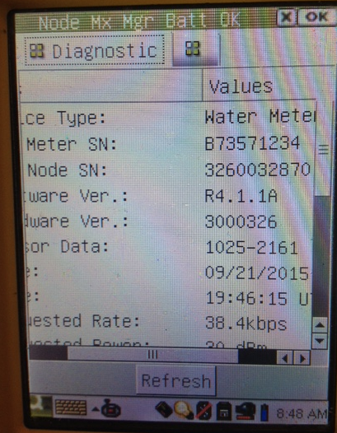
Getting a Water Meter Read with the Field Tool
Start in Node MX Mgr
Enter MAC address

Slide 28
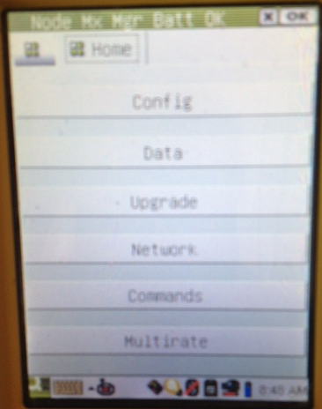
Getting a Water Meter Read with the Field Tool
Tap on next Folder
Next tap on Commands tab

Slide 29
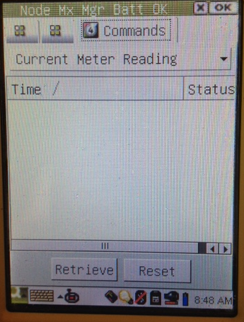
Getting a Water Meter Read with the Field Tool
Make sure “Current Meter Reading is displayed

Slide 30
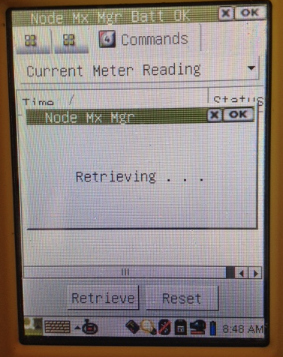
Getting a Water Meter Read with the Field Tool
Tap on retrieve, screen will show ‘Retrieving

Slide 31
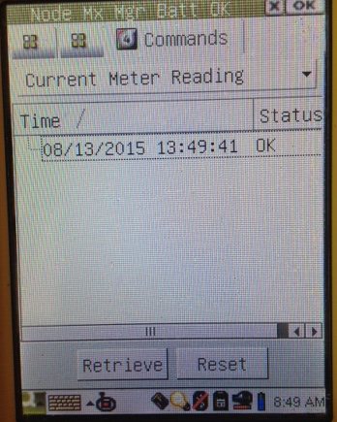
Getting a Water Meter Read with the Field Tool
Field Tool will bring back time and date

Slide 32
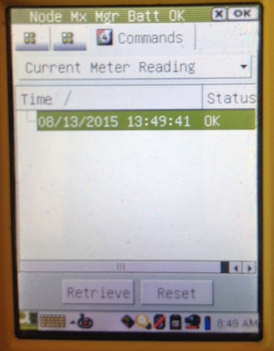
Getting a Water Meter Read with the Field Tool
Tap on date and time to highlight the line, you may need to tap twice

Slide 33
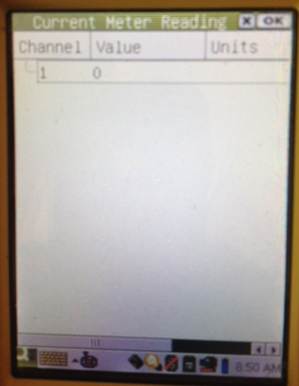
Getting a Water Meter Read with the Field Tool
Reading will display value based on how you set up the read. i.e. 100 of gallons, etc. (This particular water meter has never been used so the reading is “0”.
You can use these same steps to also read electric meters

Slide 34
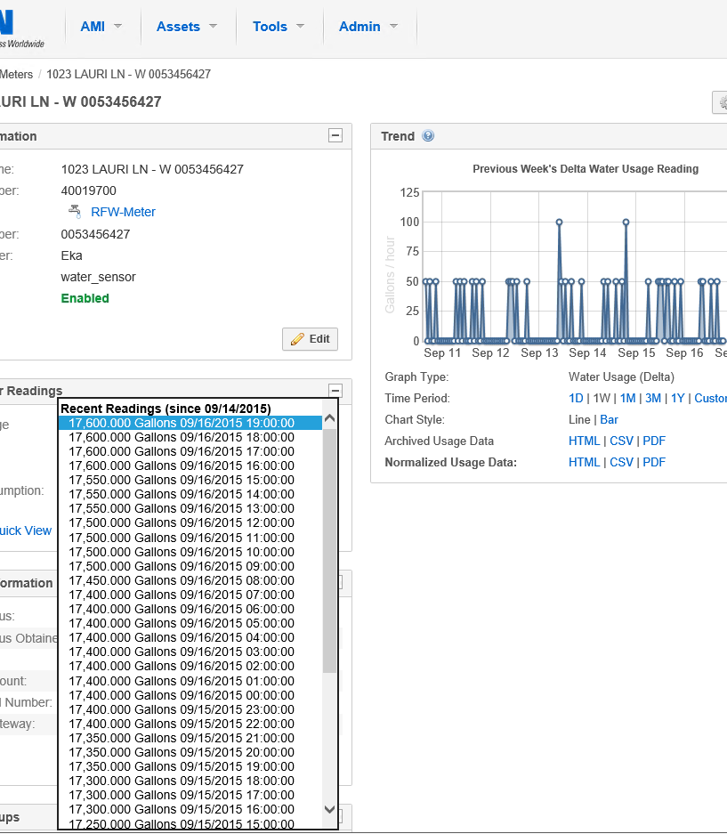
Reading a Water Meter in Yukon™

Slide 35
Water Node Troubleshooting

Slide 36
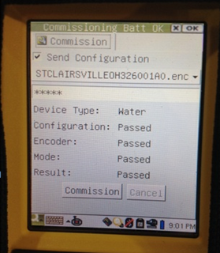
Water Node Troubleshooting

Slide 37
Water Node Troubleshooting

Slide 38
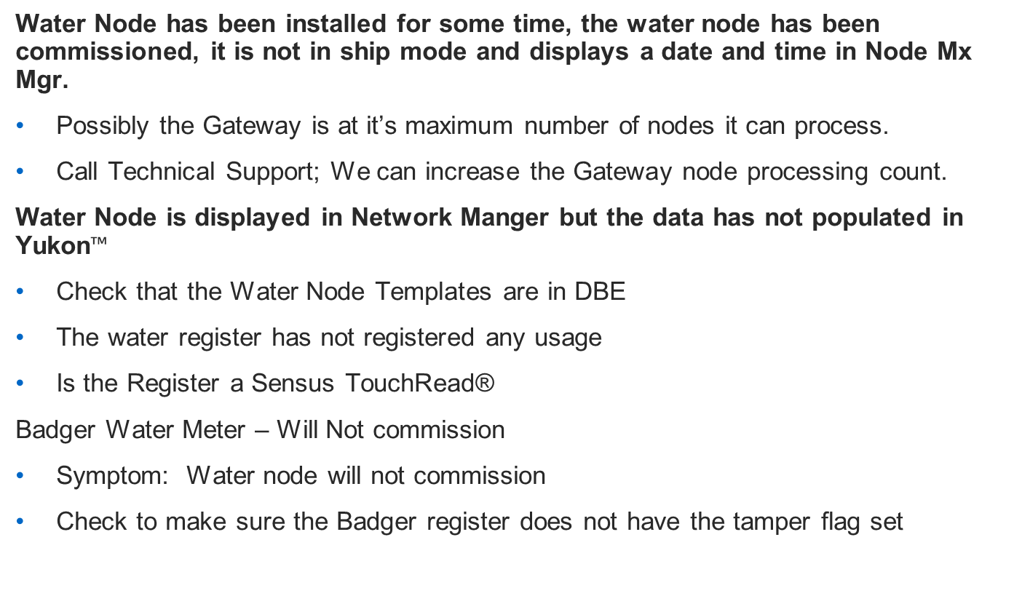
Water Node Troubleshooting
Water Node has been installed for some time, the water node has been commissioned, it is not in ship mode and displays a date and time in Node Mx Mgr.
Possibly the Gateway is at it’s maximum number of nodes it can process.
Call Technical Support; We can increase the Gateway node processing count.
Water Node is displayed in Network Manger but the data has not populated in Yukon$™$
Check that the Water Node Templates are in DBE
The water register has not registered any usage
Is the Register a Sensus TouchRead®
Badger Water Meter – Will Not commission
Symptom: Water node will not commission
Check to make sure the Badger register does not have the tamper flag set

Slide 39
Upgrading the Field Tool
Periodically your field tool will need to be update
Typically Technical Services will inform you when an update is needed.
Technical Services will send you the how to documents along with the upgrade files.
Please call Technical Support if you have questions during the update.
1-800-815-2258

Slide 40
Your Scenarios
What scenarios have you run up against?

Slide 41
Final Thoughts with Water Node Deployment
Patience
Accuracy
Wiring
Location

Slide 42



